Slide 1

Low-Complexity Convolutional Neural Network for Salt and Pepper Noise Removal in Digital Images
IV B.Tech Project Review - 1
Team Members
J. A. Sai Santosh (20PA1A0462)
K. N. V. N. Gupta (20PA1A0478)
M. Srihari (20PA1A0491)
N. S. S. N. Venkat (20PA1A04B1)
K. Yogisuhas Reddy (21PA5A0415)
Project Guide
Mr. B. Prudhvi Raj
Assistant Professor
Department of Electronics and Communication Engineering
Vishnu Institute of Technology (Autonomous)

Slide 2
Contents
Abstract
Introduction
Sample Salt and Pepper Noise Images
Classification of Non-Linear Noise Removal Methods
Literature Survey
References

Slide 3
Abstract
Digital images are may get affected by Gaussian noise, Salt and pepper noise, Speckle noise during transmission, capturing and storage.
Salt and pepper noise is one of the major noise types, it degrades the image with black and white spots resulting in the loss of required information.
Hence, restoration of impulse noise free digital image is a challenging task to fulfill the various applications fruitfully in the fields such as medical, security, communication etc...
Restoration of digital images has been carried out with various non-linear methods and they performed well upto mid level noise density.

Slide 4
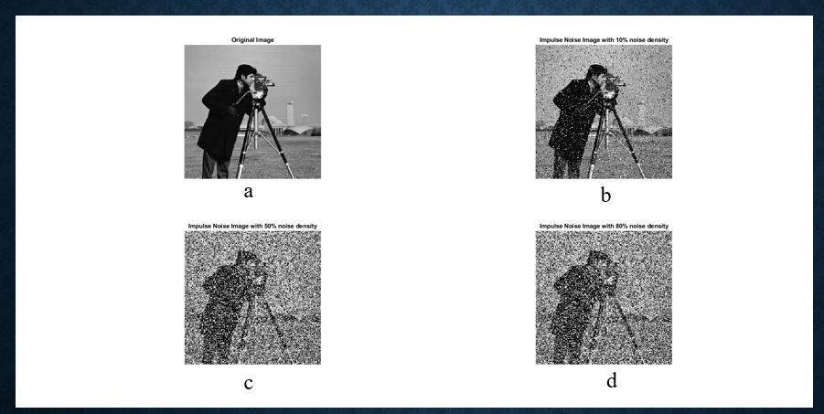
Introduction
Digital Images are get affected by Salt and pepper noise (SPN) and AWGN due to noisy camera sensors, imperfect transmission and storage.
Salt and pepper Noise (SPN)
Fixed Valued
Random Valued
Image Degraded with “black and white” spots
Intensity of Black Spot: 0
Intensity of White Spot: 2^{b}-1
‘b’ is no. of bits to represent each pixel in gray-scale image
Noise values are equally distributed throughout the image
Image Degraded with “black and white” spots with various intensity values from 0 to 2^{b}-1
‘b’ is no. of bits to represent each pixel in gray-scale image
Noise values of range
[0, 2^{b}-1] are distributed unequally throughout the image
Figure 2: (a) Cameraman Image of size 256 x 256
(b) Salt and pepper noise image (10% noise density)
(c) Salt and pepper noise image (50% noise density)
(d) Salt and pepper noise image (80% noise density)
Figure 1: Classification of Salt and pepper

Slide 5
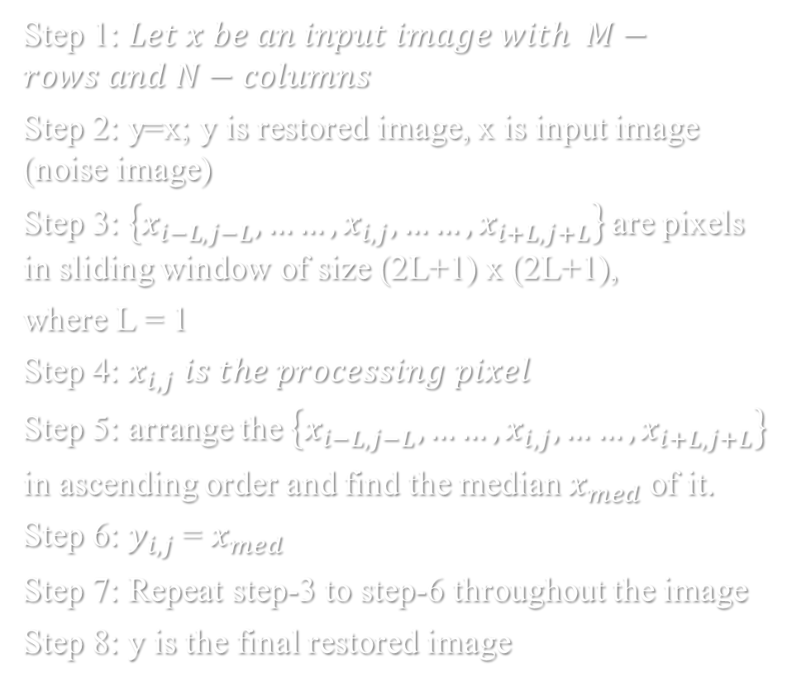
Various non-linear methods have been proposed by researchers for Salt and pepper noise removal form more than four decades.
Algorithm-1 (Median Filter)
Impulse Noise/Salt and Pepper noise Removal
Non-Linear Methods
Median filter
Switching type Median Filters
Rank order Switching Median Fi Filters
Adaptive based Median Filters
Hybrid Median Filters
Figure 3: Categories of Non-linear methods

Slide 6
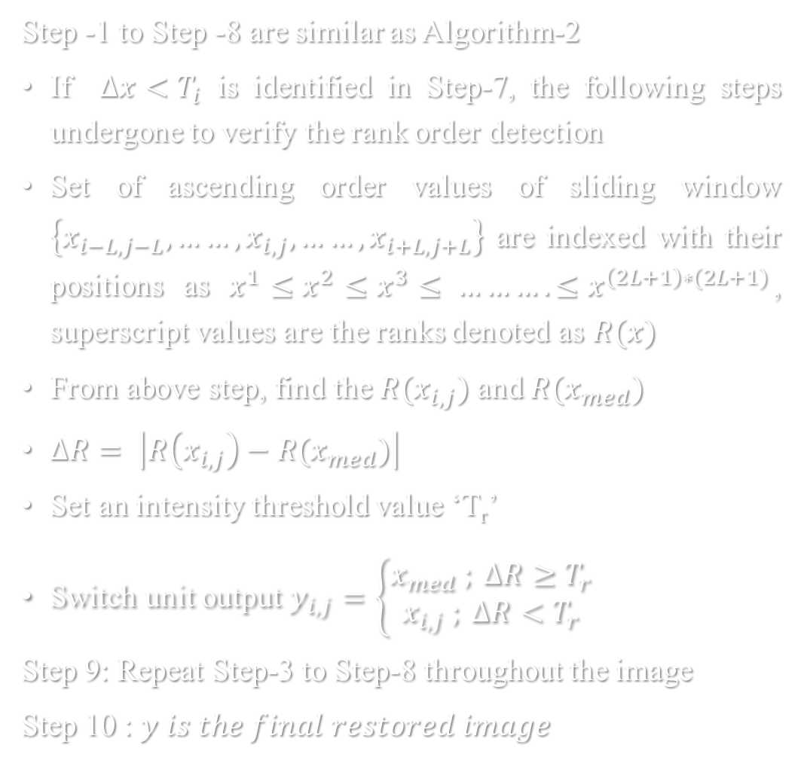

Algorithm-2
(Switching Median Filter)
Algorithm-3
(Rank ordered Median Filter)

Slide 7
Hence, they are very easy to implement and most of them are not that much robust at middle and higher noise density circumstances.
Further, various researchers have been implemented wavelet transform based restoration methods such as SWT and DWT. In these, most of them work well up to 50% noise density conditions. Very few worked well at higher noise density conditions.
To overcome these problems CNN’s based methods have been developed tremendously by various researchers from last decade and these methods require huge number of images to train the network.

Slide 8
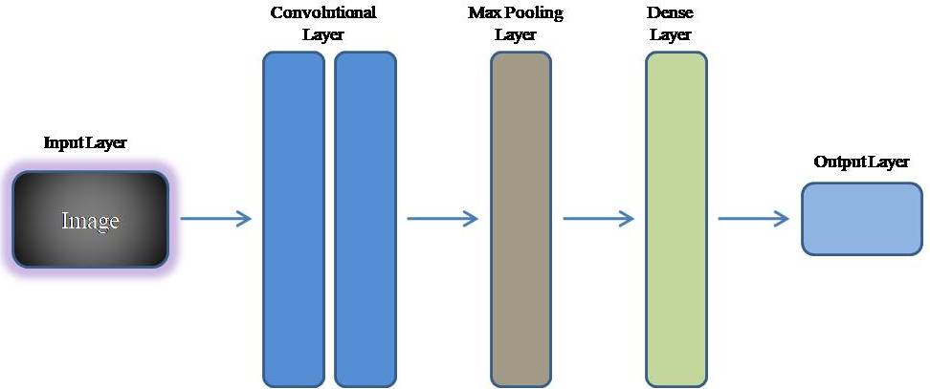
Convolutional Neural Network (CNN)
Convolutional neural network is one of the main categories to do image recognition, images classification, image restoration, Object detection and face recognition etc.…
It has 5 layers:
1. Input layer
2. Convolutional layer
3. Pooling layer
4. Fully connected layer.
5. Output layer.
Fig.4. General Architectural flow of CNN

Slide 9
Literature Survey
A denoising CNN (DnCNN) is the framework designed to remove higher density impulse noise. In this method predictor has detects the noise components based on feature vector map composed by statistical features such as rank-ordered absolute differences (ROADs), clean pixel median deviation (CPMD), and edge pixel difference (EPD).
An CNN network with twenty layers has been trained with 400 images accessed from Berkeley Segmentation Dataset (BSD) to remove higher level of impulse noise.
The CNN frameworks to deny Gaussian mixed impulse noise by train the network with hyper spectral image dataset and simplified transfer learning methods.
A two-part CNN model, trained by various levels of noise images with features of noise models such as Impulse noise (IN) and AWGN. In testing phase of the network, removal of IN takes place in first half, followed by Gaussian noise removal as second half.

Slide 10
Objective
Since most CNN models are created with multiple layers, which increases network complexity, they can attain good accuracy at greater noise densities. Moreover, when network complexity is great, training time is excessive. In order to remove salt and pepper noise from digital images, the focus of this project is to create a low-complexity CNN model.

Slide 11
References
N. Singh, T. Thilagavathy, R. T. Lakshmipriya and O. Umamaheswari, "Some studies on detection and filtering algorithms for the removal of random valued impulse noise," in IET Image Processing, vol. 11, no. 11, pp. 953-963, 11 2017, doi: 10.1049/iet-ipr.2017.0346
Removal of High Density Salt and Pepper Noise Through Modified Decision Based Unsymmetric Trimmed Median Filter S. Esakkirajan, T. Veerakumar, Adabala N. Subramanyam, and C. H. PremChand.
Kim, D.G., Hussain, M., Adnan, M., Farooq, M.A., Shamsi, Z.H. and Mushtaq, A., 2020. Mixed Noise Removal Using Adaptive Median Based Non-local Rank Minimization. IEEE Access.
M. S. Darus, S. N. Sulaiman, I. S. Isa, Z. Hussain, N. M. Tahir and N. A. M. Isa, "Modified hybrid median filter for removal of low density random-valued impulse noise in images," 2016 6th IEEE International Conference on Control System, Computing and Engineering (ICCSCE), Penang, Malaysia, 2016, pp. 528-533, doi: 10.1109/ICCSCE.2016.7893633.
R. Sravani, K. Srinivas and P. Raj.B, "Removal of Low-DENSITY Impulse Noise From Grayscale Images Using New Modified Hybrid Median Filter With Various Sliding Window Sizes," 2018 3rd IEEE International Conference on Recent Trends in Electronics, Information & Communication Technology (RTEICT), Bangalore, India, 2018, pp. 1750-1754, doi: 10.1109/RTEICT42901.2018.9012348.
J. Chen, G. Zhang, S. Xu and H. Yu, "A Blind CNN Denoising Model for Random-Valued Impulse Noise," in IEEE Access, vol. 7, pp. 124647- 124661, Sept. 2019, doi: 10.1109/ACCESS.2019.2938799.
M. Mafi, W. Izquierdo and M. Adjouadi, "High Impulse Noise Intensity Removal in Natural Images Using Convolutional Neural Network," 2020 10th Annual Computing and Communication Workshop and Conference (CCWC), Las Vegas, NV, USA, Mar. 2020, pp. 0673-0677, doi: 10.1109/CCWC47524.2020.9031200.
B. Lin, X. Tao and J. Lu, "Hyperspectral Image Denoising via Matrix Factorization and Deep Prior Regularization," in IEEE Transactions on Image Processing, vol. 29, pp. 565-578, 2020, doi: 10.1109/TIP.2019.2928627.
M.T. Islam, S.M.M. Rahman, M.O. Ahmad, M.N.S. Swamy, “Mixed Gaussian-impulse noise reduction from images using convolutional neural network,” in Signal Processing: Image Communication, vol. 68, pp. 26-41, Oct. 2018, https://doi.org/10.1016/j.image.2018.06.016.
R. Abiko and M. Ikehara, "Blind Denoising of Mixed Gaussian-impulse Noise by Single CNN," ICASSP 2019 - 2019 IEEE International Conference on Acoustics, Speech and Signal Processing (ICASSP), Brighton, UK, Apr. 2019, pp. 1717-1721, doi: 10.1109/ICASSP.2019.8683878.

Slide 12
Thank You

